Slide 1
Irl Adventures
Dylan Fassio
Nick Persaud
Sean Steben

Slide 2
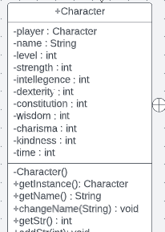
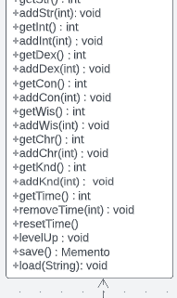
Singleton
Stores character data like name, level, and stats in the Character class
Only one instance of a character at a time, need to make sure every time a stat is updated it goes to the same character.

Slide 3
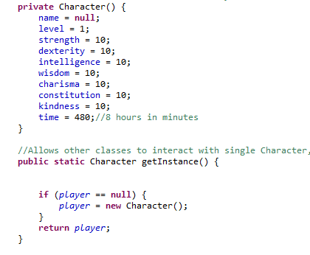
Singleton Cont.
Private constructor
getInstance method ensures that only one Character object is made

Slide 4
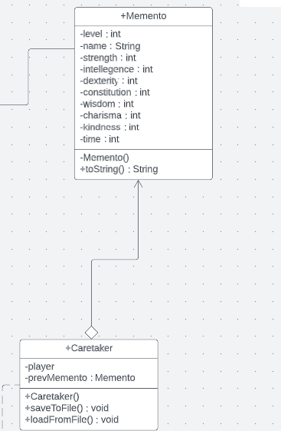
Memento
Saves character data in-between sessions

Slide 5
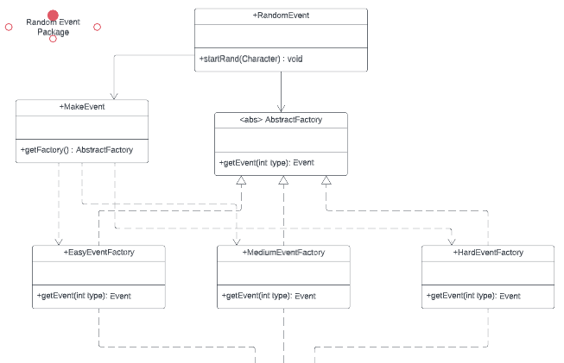
Abstract Factory
Generate random events over the course of the game
Events create a skill check, and if the character passes they level up.
Uses Abstract Factory to determine the difficulty of the skill check based off of the user’s level.

Slide 6
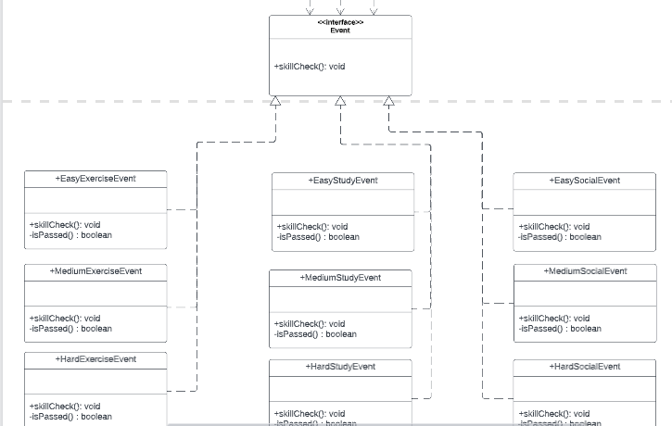
Abstract Facory Cont.
Which type of event that occurs is randomly selected.
Multiple difficulties for each type.

Slide 7
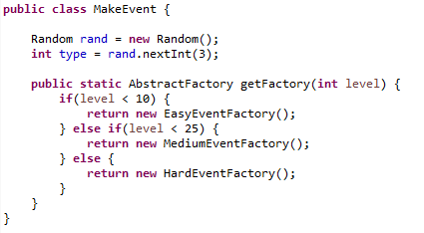
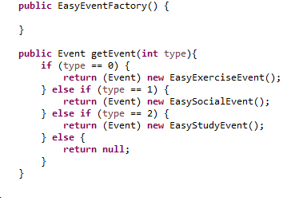

Slide 8
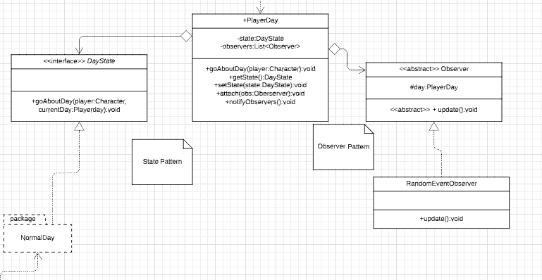
State and Observer (Context Class)
Player Day is the glue for for the state and observers patterns
Serves as context/subject for both

Slide 9
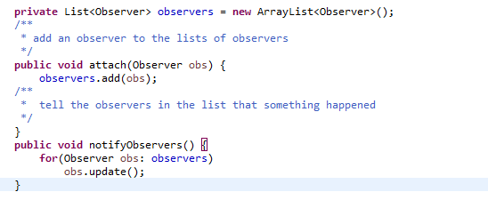
Observer Pattern
Within PlayerDay class

Slide 10

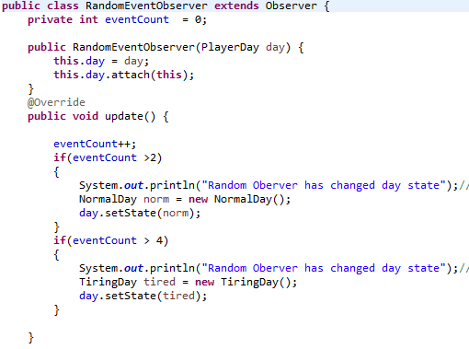
Observer
Blueprint for all observer classes
Attached is called in player day
When update is called observer might change state of day

Slide 11
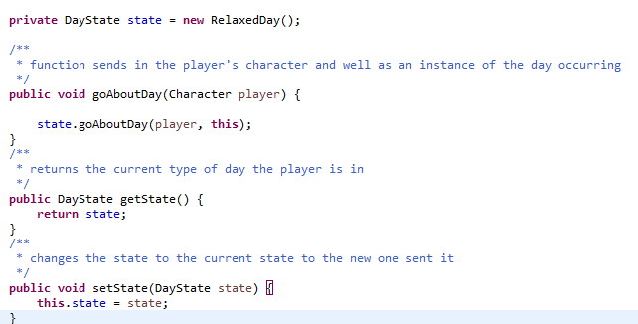
State Pattern
Within PlayerDay

Slide 12
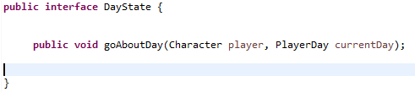
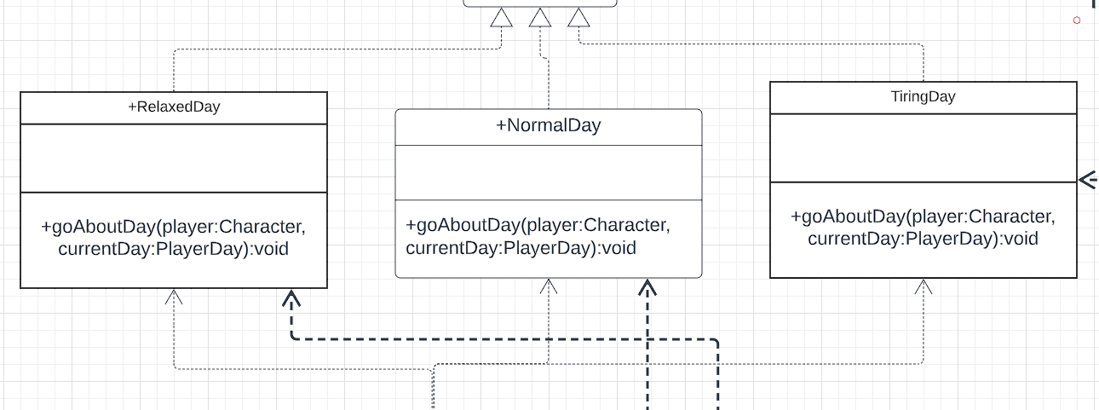
State Pattern
Blueprint for different states

Slide 13
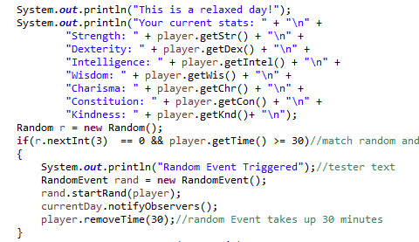
State and Observer
When a random event happens, the observer is told
currentDay.notifyObservers();

Slide 14
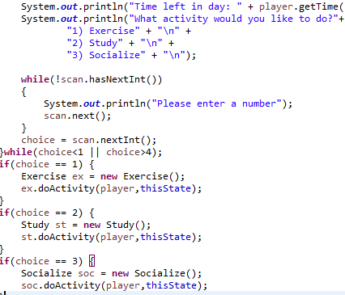
Moving into Template Pattern
Each state can start whatever activity they want to do

Slide 15
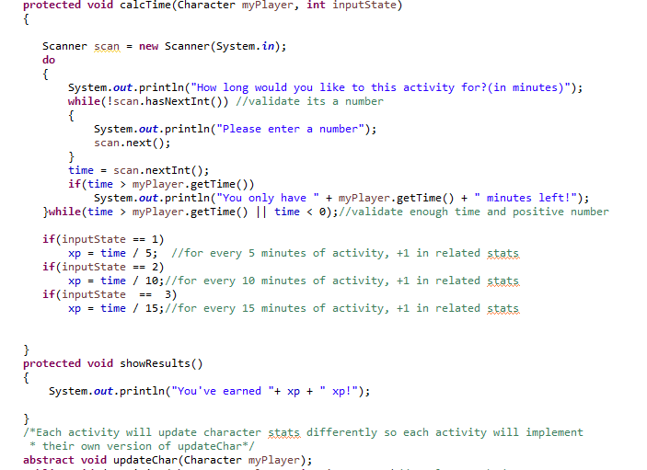
Template
“Recipe” is the same except for updateChar(myPlayer)

Slide 16
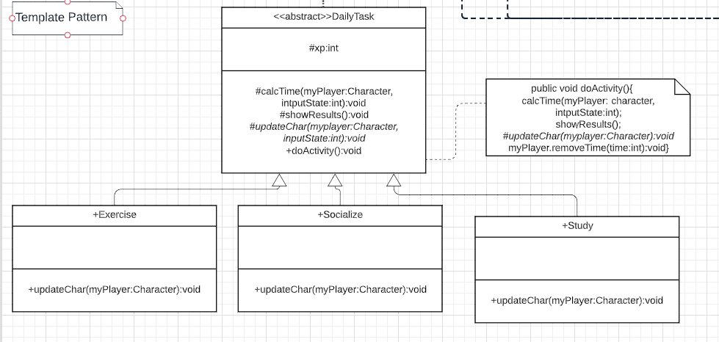
Template
Each activity is similar in execution but with 1 small difference

Slide 17
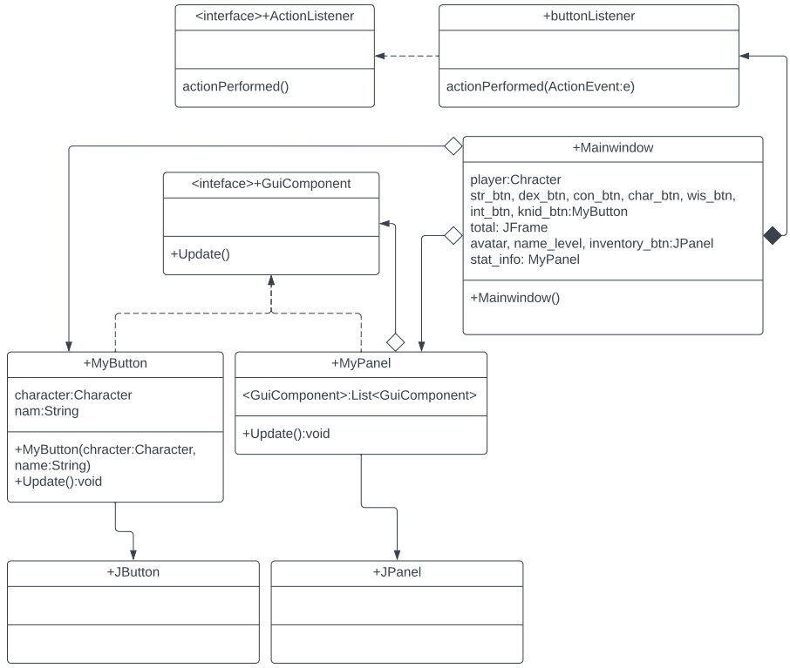
Composite UML
Composite used on Buttons and Panels
Ability to use update on buttons to show new stats when there is a a level up
Groups components together incase they need to change latter

Slide 18
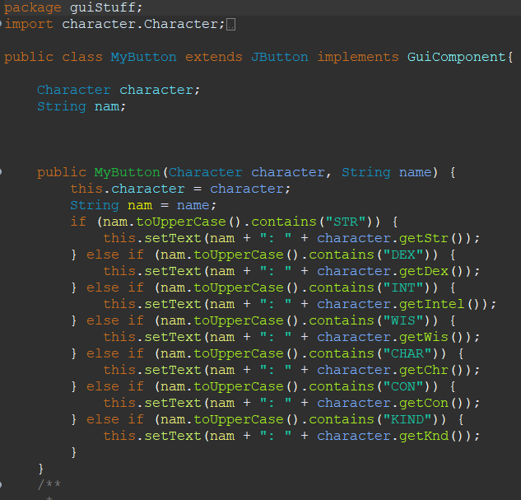
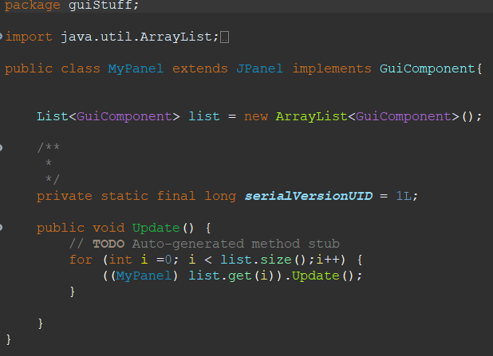
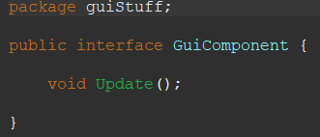
Composite Code
MyPanel stores all components inside it
When update called MyPanel calls it on all components
MyButton changes text

Slide 19
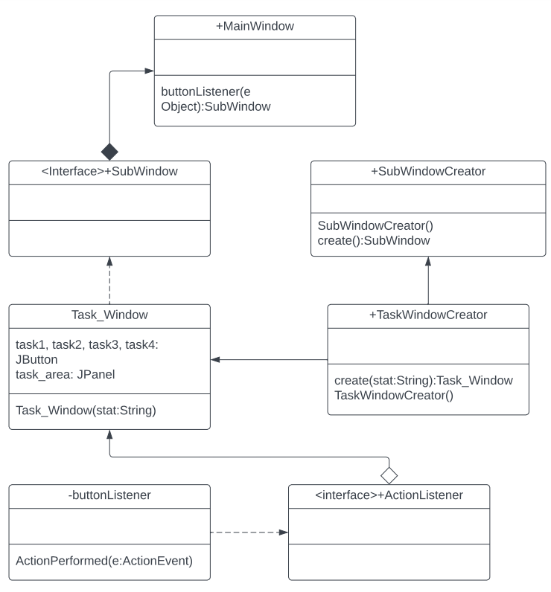
Abstract Factory UML
This is for the creation and implementation of all the subwindows that the program can make
Both the creator and window have interfaces they can implement
The creator then builds the necessary window

Slide 20
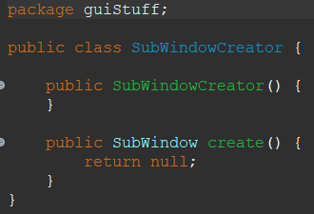
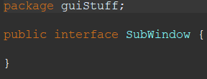
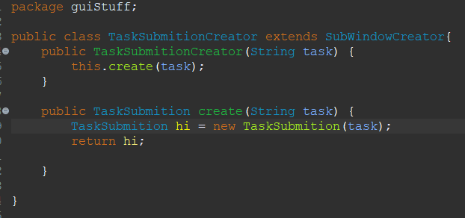
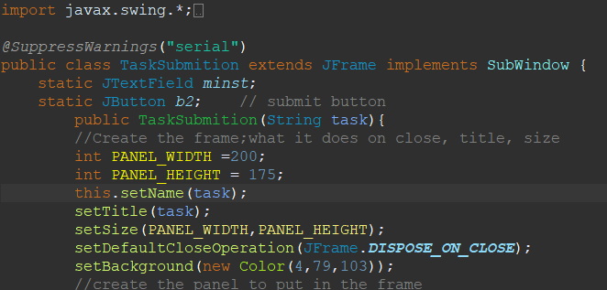
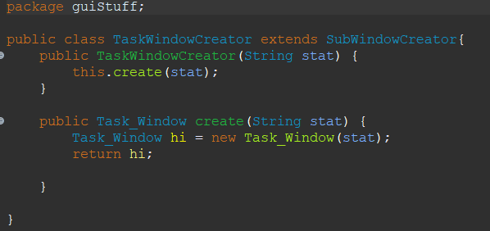
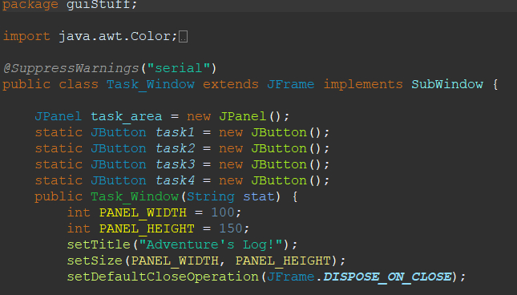
Abstract Factory Code
Each one has a creator for it that implements the actual subwindow
This was due to the fact that I didn’t know what each subwindow needed so they all very by a lot

Slide 21
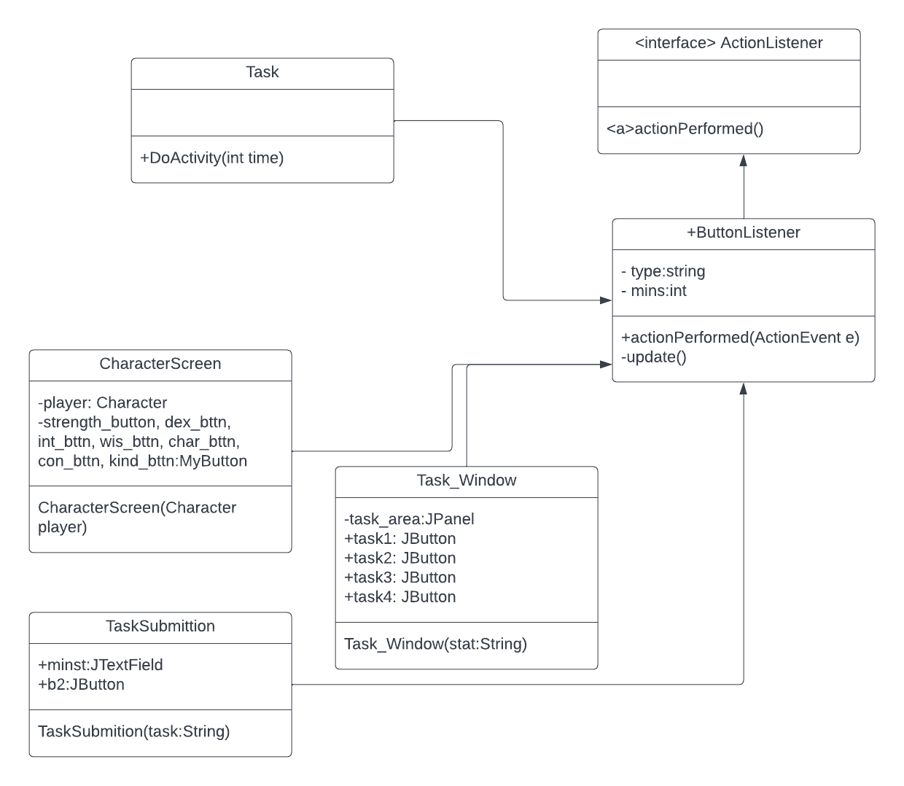
MVC UML
Used so the window can listen for actions to occur
Task interacts with Listener and all windows look at listener
Task and Windows don’t need to interact with each other

Slide 22
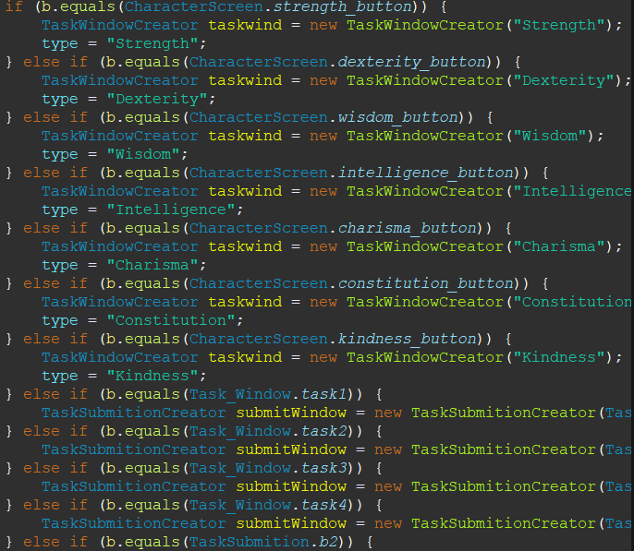
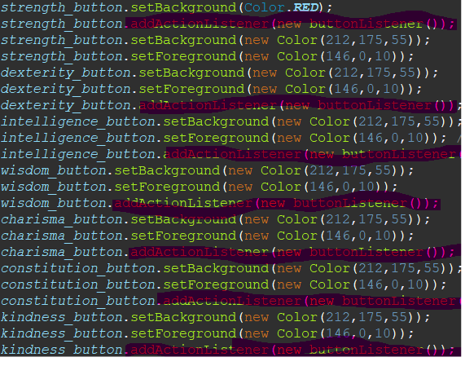
MVC Code
The button listeners is where all the events occur it just needs to be able to view what is going to occur so it is attached to the buttons when they are made.

